Slide 1
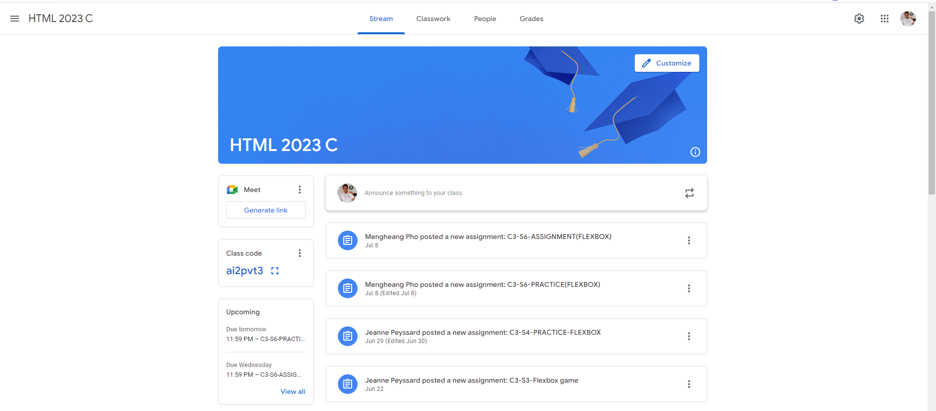
Identify root components of website below

Slide 2
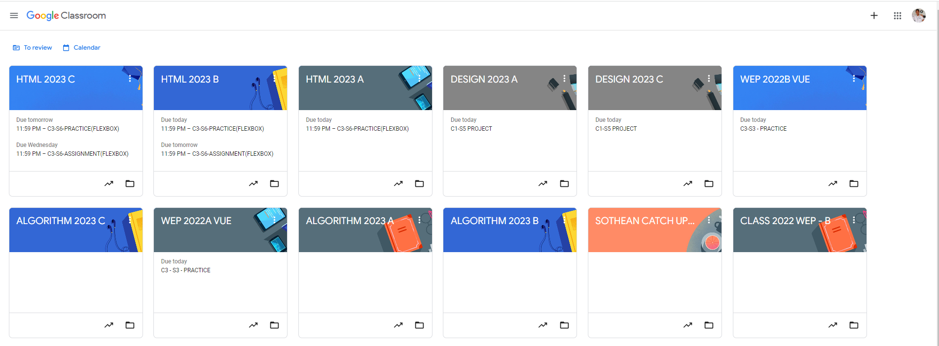
Root div
- Height: 100vh
content
nav
Flex: 0
header
Flex: 0
Flex: 1

Slide 3
Flex-Direction: Column
Navigation
Content
Container

Slide 4
Navigation
Navigation Left
Navigation Center
Navigation Right

Slide 5
Container Flex-Direction: Column
Main Content
Main Sidebar

Slide 6
Main Sidebar Flex-Direction: Column
Sub Sidebar 1
Sub Sidebar 2
Sub Sidebar 3

Slide 7
Main-Content Flex: Column
Individual bar 1
Individual bar 2
Individual bar 3
Individual bar 4
Individual bar 5

